Slide 2


Slide 3
Lessons From the Prophet Isaiah
“Refocusing our JOY”
Isaiah 54 - 55

Slide 4
You will go out in joy and be led forth in peace; the mountains and hills will burst into song before you, and all the trees of the field will clap their hands.
Isaiah 55:12 (NIV)

Slide 5
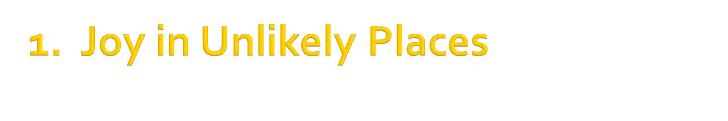
The barren woman
“Sing, O barren woman, you who never bore a child” (v1).

Slide 6
The barren woman
“Sing, O barren woman, you who never bore a child” (v1).
The deserted wife
“’You were a wife deserted and distressed in spirit–a wife who married young, only to be rejected,’ says your God” (v6).

Slide 7
The barren woman
“Sing, O barren woman, you who never bore a child” (v1).
The deserted wife
“’You were a wife deserted and distressed in spirit–a wife who married young, only to be rejected,’ says your God” (v6).
The ruined city
“O afflicted city, lashed by storms and not comforted…” (v11).

Slide 8
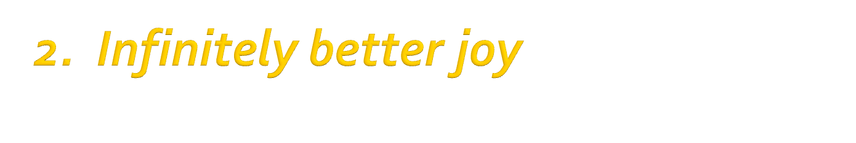
"Do not be afraid; you will not suffer shame. Do not fear disgrace; you will not be humiliated. You will forget the shame of your youth and remember no more the reproach of your widowhood” (v4).

Slide 9
"Do not be afraid; you will not suffer shame. Do not fear disgrace; you will not be humiliated. You will forget the shame of your youth and remember no more the reproach of your widowhood” (v4).
“For your Maker is your husband--the Lord Almighty is his name--the Holy One of Israel is your Redeemer; he is called the God of all the earth” (v5).

Slide 10
"O afflicted city, lashed by storms and not comforted, I will build you with stones of turquoise, your foundations with sapphires. I will make your battlements of rubies, your gates of sparkling jewels, and all your walls of precious stones” (v11-13).

Slide 11
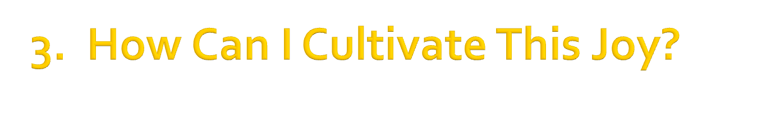
"Come, all you who are thirsty, come to the waters; and you who have no money, come, buy and eat!” (55:1).

Slide 12
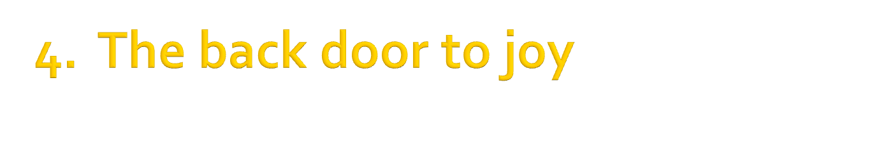

Slide 13
John Newton’s experience:
I Asked the Lord that I Might Grow, 1779

Slide 14

"Come, all you who are thirsty, come to the waters; and you who have no money, come, buy and eat!
Come, buy wine and milk without money or cost. Seek the Lord while he may be found” (v1,6).

